Slide 3
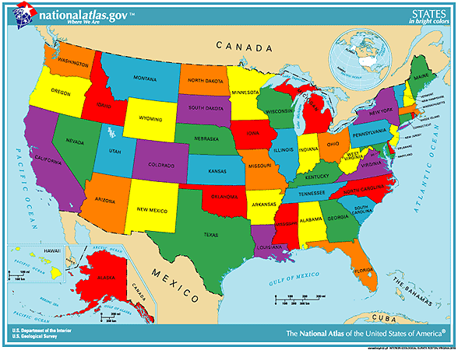
U.S. Housing

Slide 4
Annual Home Sales
9000000
8000000
7000000
6000000
5000000
4000000
New Existing
3000000
2000000
1000000
0
2000 2001 2002 2003 2004 2005 2006 2007 2008 2009 2010 2011 2012 2013 2014 2015

Slide 5
Buyer Traffic By State

Slide 6
Rent Growth
2011 - 2016
4.5
4.0
3.5
3.0
2.5
2.0
1.5
1.0
0.5
0.0

Slide 7
Wealth Gap Between Young Adults (under-35) and Retiree (65+)
Median net worth of households headed by…
$250,000
$230,000
$210,500
$200,000
$150,000
$120,524
$100,000
$50,000
$15,260
$10,460
$8,500
$0
1983
2013
2016 est.

Slide 8
Student Loan Debt
2006 - 2016
1600
1400
1200
1000
800
600
400
200
0
200620062007200720082008200920092010201020112011201220122013201320142014201520152016
- Q1 - Q3 - Q1 - Q3 - Q1 - Q3 - Q1 - Q3 - Q1 - Q3 - Q1 - Q3 - Q1 - Q3 - Q1 - Q3 - Q1 - Q3 - Q1 - Q3 - Q1

Slide 9
Distressed Property Sales 2008 – 2016 % of Total Sales
Short Sale Foreclosure
60
50
40
30
20
10
0
2008 - Oct
2009 - Jan
2009 - Apr
2009 - Jul
2009 - Oct
2010 - Jan
2010 - Apr
2010 - Jul
2010 - Oct
2011 - Jan
2011 - Apr
2011 - Jul
2011 - Oct
2012 - Jan
2012 - Apr
2012 - Jul
2012 - Oct
2013 - Jan
2013 - Apr
2013 - Jul
2013 - Oct
2014 - Jan
2014 - Apr
2014 - Jul
2014 - Oct
2015 - Jan
2015 - Apr
2015 - Jul
2015 - Oct
2016 - Jan
2016 - Apr
2016 - Jul

Slide 10
Investor Sales
(% of Total Sales; 12-month average)
22
20
18
16
14
12
10
2009 - Sep
2009 - Dec
2010 - Mar
2010 - Jun
2010 - Sep
2010 - Dec
2011 - Mar
2011 - Jun
2011 - Sep
2011 - Dec
2012 - Mar
2012 - Jun
2012 - Sep
2012 - Dec
2013 - Mar
2013 - Jun
2013 - Sep
2013 - Dec
2014 - Mar
2014 - Jun
2014 - Sep
2014 - Dec
2015 - Mar
2015 - Jun
2015 - Sep
2015 - Dec
2016 - Mar
2016 - Jun
2016 - Sep

Slide 11
Median Expected Price Growth in Next 12 Months by State

Slide 12
Single-family Housing Permits and Starts –
Grossly Inadequate
2000
1800
1600
1400
1200
1000
800
600
400
200
0
Thousand units
2000 - Jan
2000 - Jun
2000 - Nov
2001 - Apr
2001 - Sep
2002 - Feb
2002 - Jul
2002 - Dec
2003 - May
2003 - Oct
2004 - Mar
2004 - Aug
2005 - Jan
2005 - Jun
2005 - Nov
2006 - Apr
2006 - Sep
2007 - Feb
2007 - Jul
2007 - Dec
2008 - May
2008 - Oct
2009 - Mar
2009 - Aug
2010 - Jan
2010 - Jun
2010 - Nov
2011 - Apr
2011 - Sep
2012 - Feb
2012 - Jul
2012 - Dec
2013 - May
2013 - Oct
2014 - Mar
2014 - Aug
2015 - Jan
2015 - Jun
2015 - Nov
2016 - Apr
2016 - Sep

Slide 13
Foreign Buyer Purchases: $102.6 B
(7 Percent of Existing Home Sales)
Dollar Volume of Foreign Buyer Residential Property Purchases
$120
$100
Billions
$80
$49
$59
Recent Immigrants
$60
$41
$45
$33
$33
$40
$20
$41
$47
$54
$44
Pure Foreign National
$33
$35
$0
2011
2012
2013
2014
2015
2016

Slide 14
Jobs
(8 million lost … 15 million gained)
150,000
In thousands
145,000
140,000
135,000
130,000
125,000
120,000
2000 - Jan
2000 - Jul
2001 - Jan
2001 - Jul
2002 - Jan
2002 - Jul
2003 - Jan
2003 - Jul
2004 - Jan
2004 - Jul
2005 - Jan
2005 - Jul
2006 - Jan
2006 - Jul
2007 - Jan
2007 - Jul
2008 - Jan
2008 - Jul
2009 - Jan
2009 - Jul
2010 - Jan
2010 - Jul
2011 - Jan
2011 - Jul
2012 - Jan
2012 - Jul
2013 - Jan
2013 - Jul
2014 - Jan
2014 - Jul
2015 - Jan
2015 - Jul
2016 - Jan
2016 - Jul

Slide 15
Housing Forecast
 | 2015 | 2016 Likely | 2017 Forecast | 2018 Forecast
New Home Sales | 500,000 | 570,000 | 620,000 | 700,000
Existing Home Sales | 5.3 million | 5.4 million | 5.5 million | 5.7 million
Median Price Growth | + 6.8% | +4.0% | 4.2% | 2.5%
30-year Rate | 3.9% | 3.6% | 4.1% | 4.5%

Slide 16
Local Housing Market

Slide 17
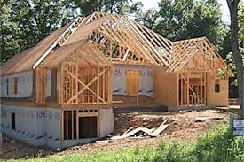
+

Slide 18
+
= 82% of Market was
Residential Resales
18% of Market was
New Construction
Sales
Notes:
New Construction National % average runs between 9-11% highest national nc % was 16%

Slide 19
TOTAL CLOSED
2016
2015
7,636
+7.9%
7,077
(+559)
Notes:
2015 WAS 5.7% higher than 2014 (+322)

Slide 20
# Sold Whole Market
Resale Market?
+9.2%
+ 7.9%
(+559)
6269
(+554)
7633

Slide 21
# Sold Whole Market
Resale Market +9.7%
New Construction ?
0.0%
+ 7.9%
(+2)
(+559)
7633
1364

Slide 22
EXISTING HOMES SALE BY THE NUMBERS

Slide 23
18%
< $75,000
80%
< $202,000
17% - Foreclosures
+9.2%
Avg Price = $142,911
+7.2%
Avg S.F. = 1835 s.f.
+0.9%
Avg $/S.F. = $78/S.F.
+6.2%
Median Days on Market = 59
(+ 556)

Slide 24
Average DAYS ON MARKET
Top Half DOM
Bottom Half DOM
Average DOM = 23 Days
Average DOM = 165 Days
< 3.2% >
162
Longest DOM = 59 Days
Longest DOM = 1550 Days

Slide 25
NEW CONSTRUCTIN BY THE NUMBERS

Slide 26
New Construction
0.0%
80%
< $283,000
(+2)
Avg. Price - $237,948
+7.7%
Avg. S.F - 2523 s.f.
+0.1%
Avg. $/S.F. - $94/S.F.
+2.9%

Slide 27
What does it mean to you?
All New Construction Appreciation $/s.f. + 2.88%
Cumberland County + 1.2%
Harnett County + 3.2%
Hoke County + 5.1%
All Residential Existing Appreciation $/S.F + 6.16%
Cumberland County + 5.5%
Harnett County + 4.3
Hoke County + 7.0%

